Slide 1
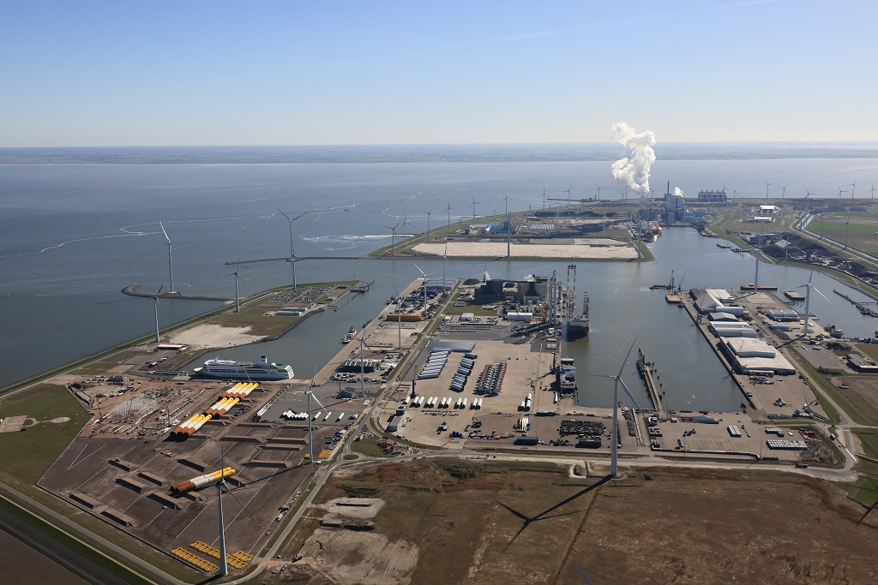
Welkom omwonenden Eemshaven
Informatiebijeenkomst | Oudeschip, 11 mei
Cas König | CEO Groningen Seaports

Slide 2
Terugkoppeling vorige bijeenkomst
● Investering in wegen
● ‘s Avonds geluidsoverlast van cruiseschip
● Gebruik schroefpalen of drukpalen in plaats van heipalen
● Wordt het niet tijd voor een bedrijfsbrandweer?
● In hoeverre is de regionale brandweer op de hoogte van de ontwikkelingen in de Eemshaven?

Slide 3
Eemshaven - 1973
Leads - initiatieven Delfzijl
Notes:
1973. You can see that the port is pretty much stuck to the coast (point to the coast line left on the picture). You can also see that it was built where the water was deep. Top right in the picture we see the island of Borkum and all the water that is dark blue is deep water.
You build a port by spraying sand This is done with a special vessel, a dredging vessel. This vessel sucks the sand from the seabed and sprays it back somewhere else until the water has disappeared.
The first business that was built in Eemshaven was a power station. You can see it at the bottom of the photo and to the left the cooling water inlet. This power station was later expanded with a second power station, and in total it is 2400 Megawatt in installed capacity. That makes it the largest gas-fired power station on the Continent.
About Megawatts, imagine 1 light bulb of 100 watt. This power station can provide enough power for 24 million of those light bulbs.

Slide 4
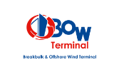
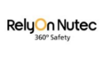
Eemshaven - 1973
H2
H2
CO2
Leads - initiatieven Eemshaven
Notes:
1973. You can see that the port is pretty much stuck to the coast (point to the coast line left on the picture). You can also see that it was built where the water was deep. Top right in the picture we see the island of Borkum and all the water that is dark blue is deep water.
You build a port by spraying sand This is done with a special vessel, a dredging vessel. This vessel sucks the sand from the seabed and sprays it back somewhere else until the water has disappeared.
The first business that was built in Eemshaven was a power station. You can see it at the bottom of the photo and to the left the cooling water inlet. This power station was later expanded with a second power station, and in total it is 2400 Megawatt in installed capacity. That makes it the largest gas-fired power station on the Continent.
About Megawatts, imagine 1 light bulb of 100 watt. This power station can provide enough power for 24 million of those light bulbs.

Slide 5
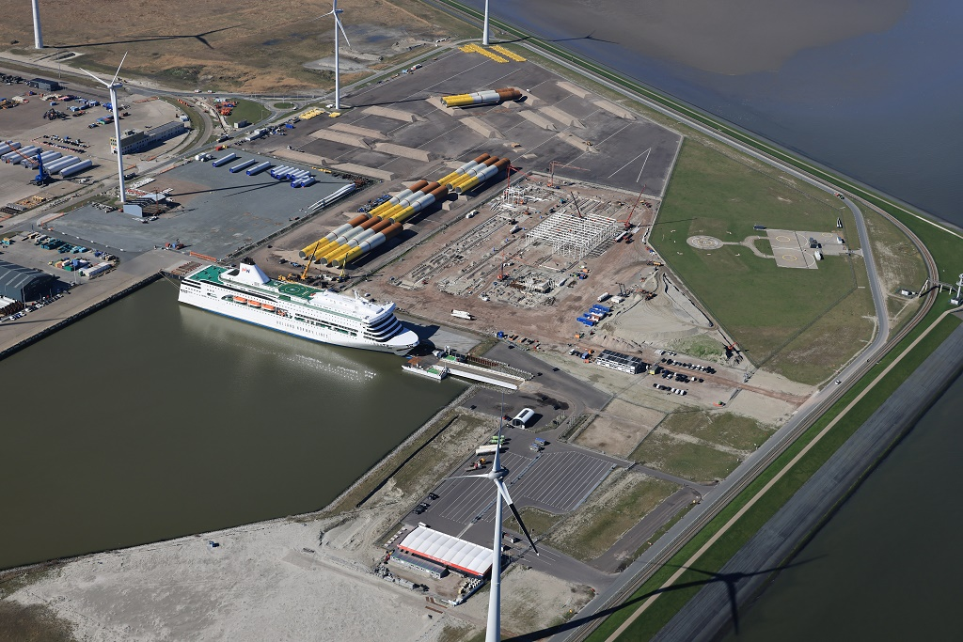
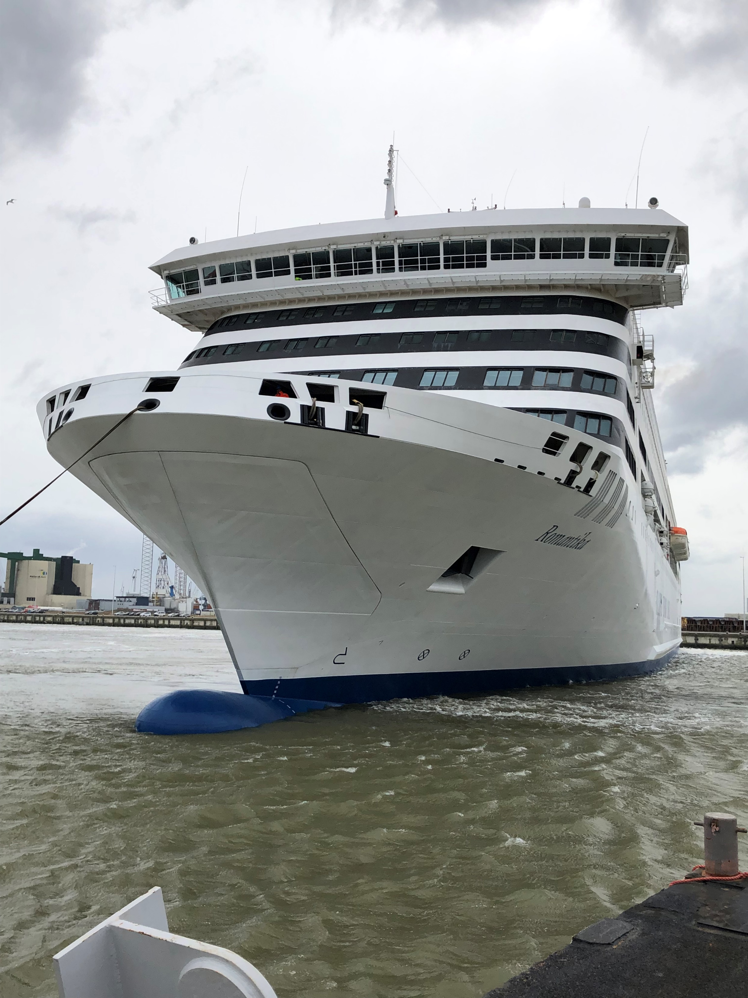
Holland Norway Lines: terminal Eemshaven-Kristiansand afgebroken

Slide 6
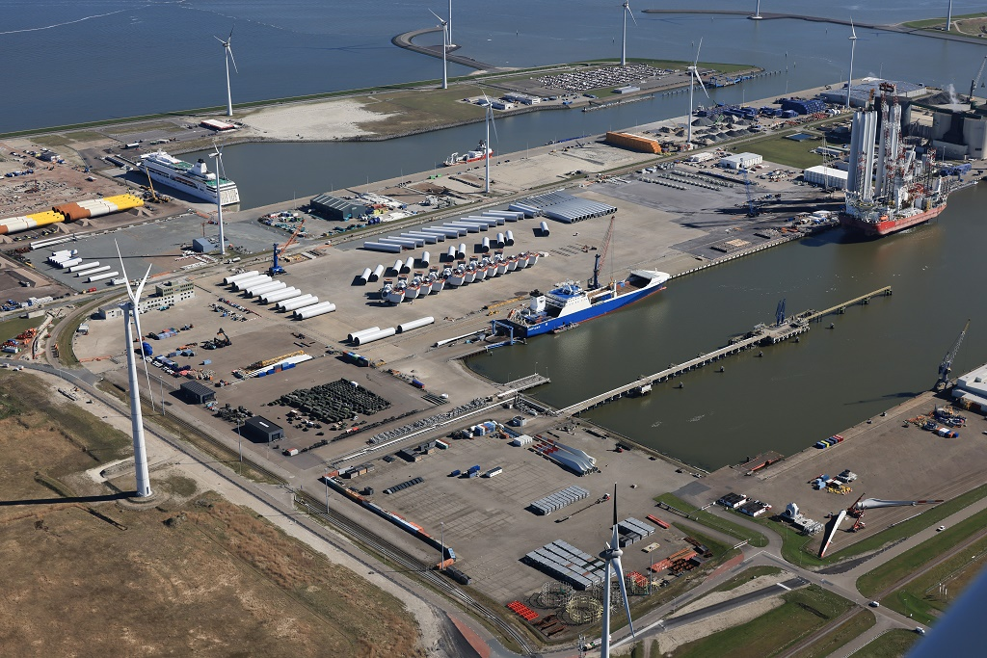
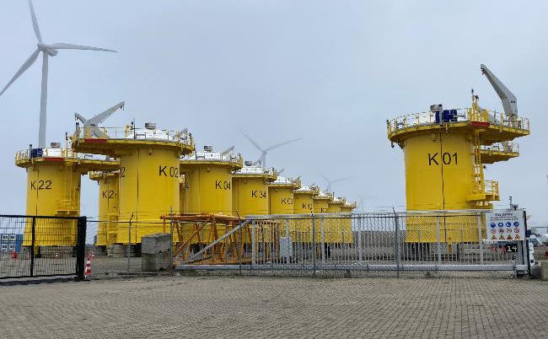
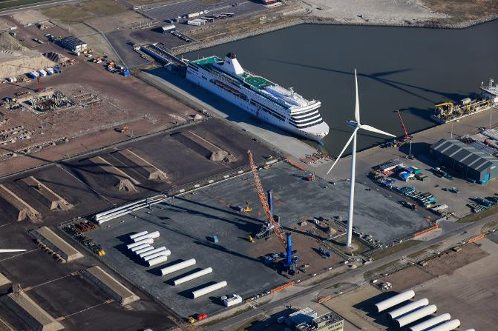
Buss Terminal Eemshaven: start 19e offshore wind project (HKN)
Kaskasi afgerond
Nieuwbouw kantoor
Uitbreiding (4 ha)

Slide 7
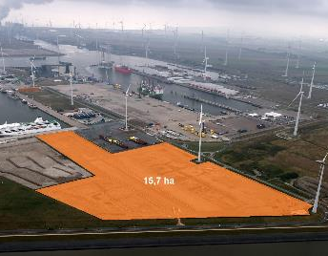
Project Gode Wind 3/Borkum Riffgrund 3 | Jan de Nul

Slide 8
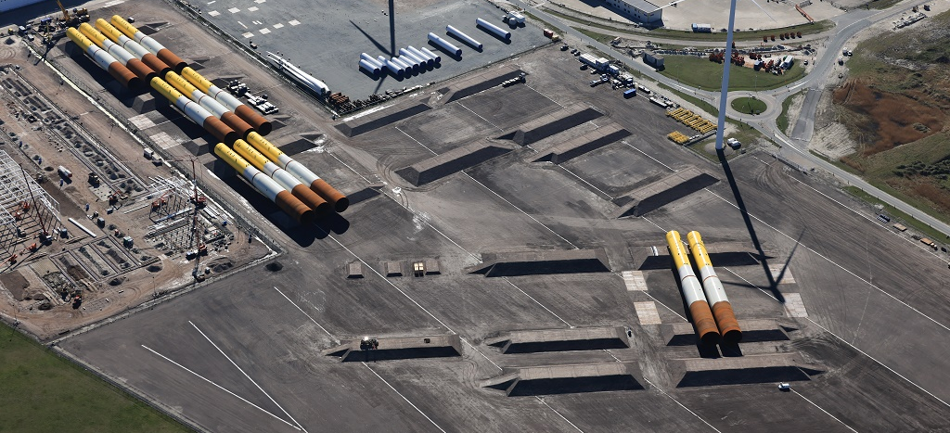
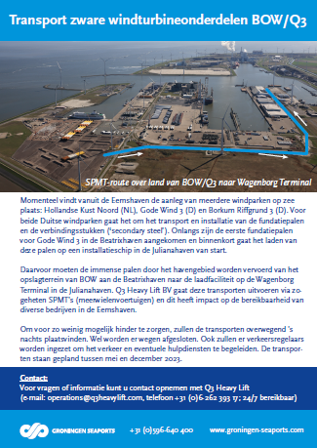
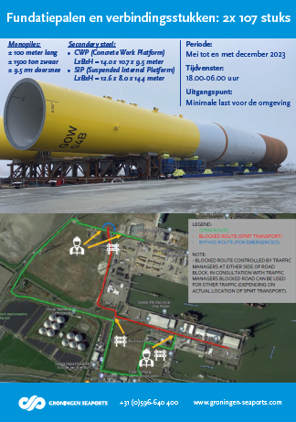
Zwaar transport: mei-dec 2023

Slide 9
Van BOW-terrein (Beatrixhaven) naar Wagenborg Terminal (Julianahaven)

Slide 10
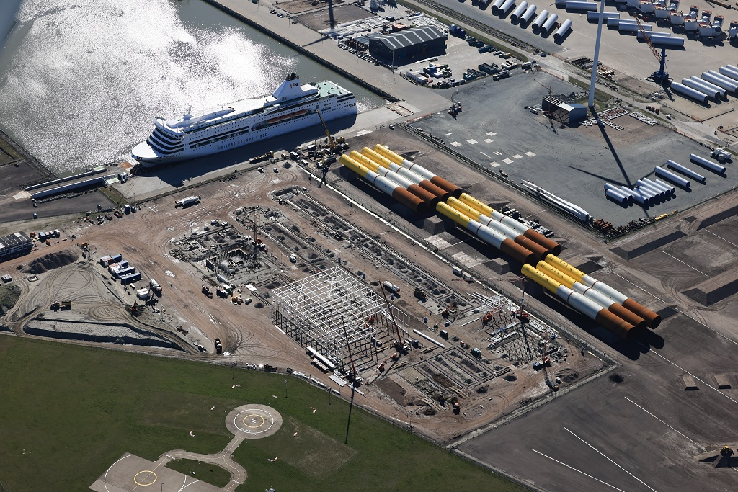
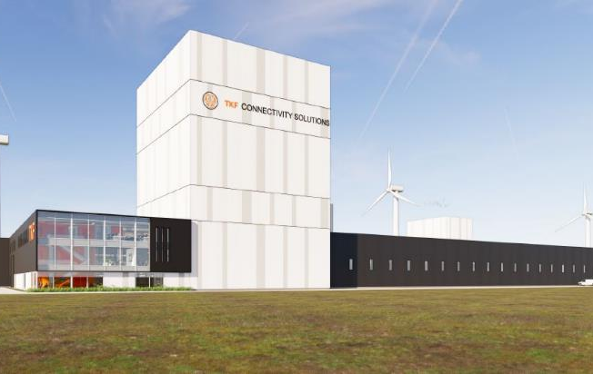
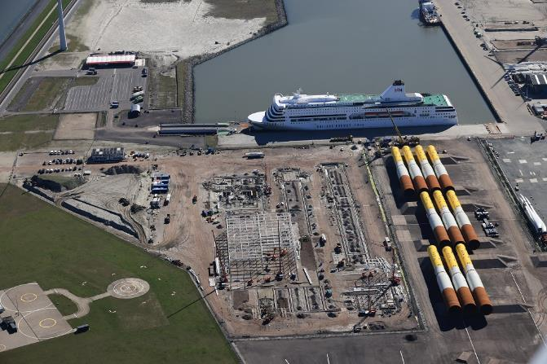
Bouw kabelfabriek TKF in volle gang

Slide 11
Eigen locaties voor Holemans Nederland en DHSS

Slide 12
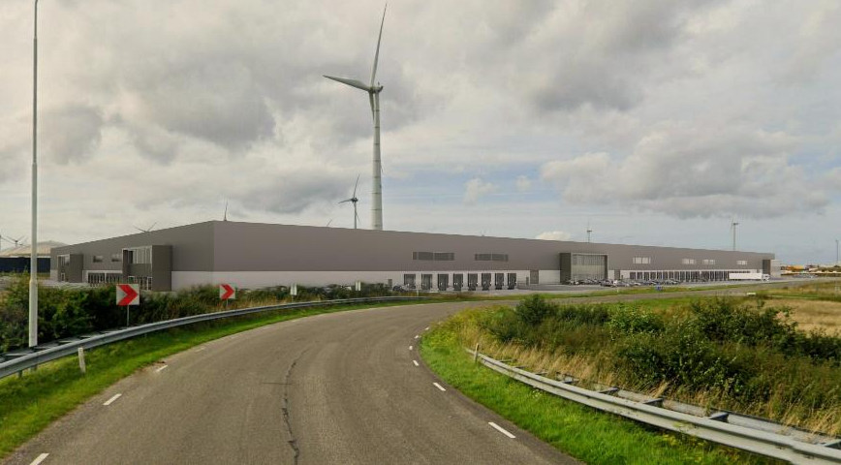
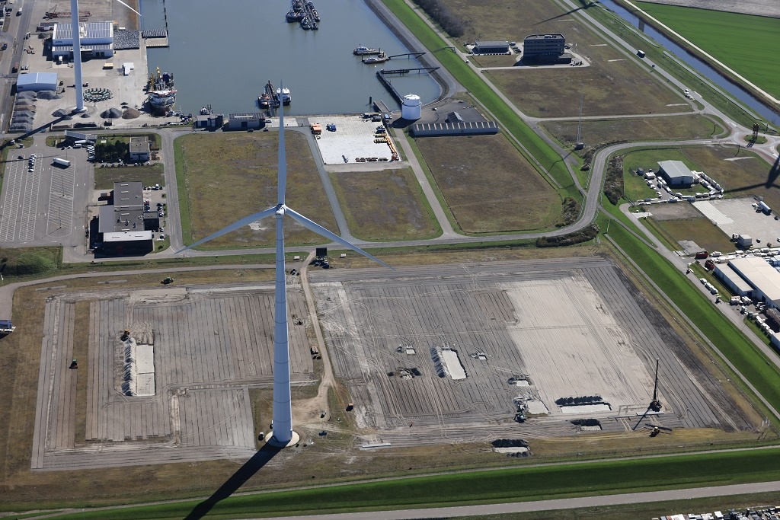
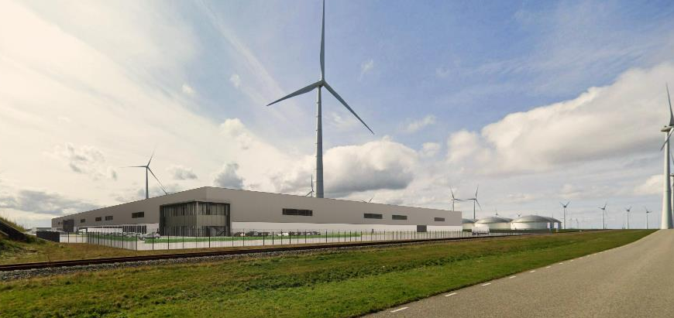
Bouw Eemshaven Distribution Centre (Necron) begonnen

Slide 13
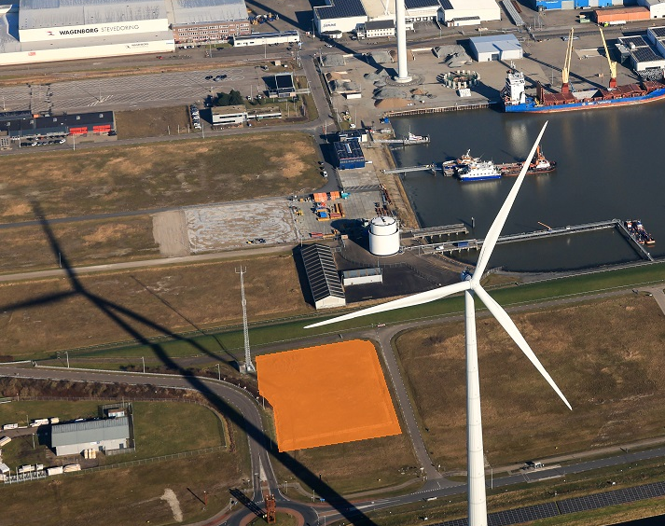
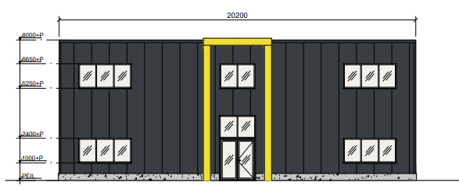
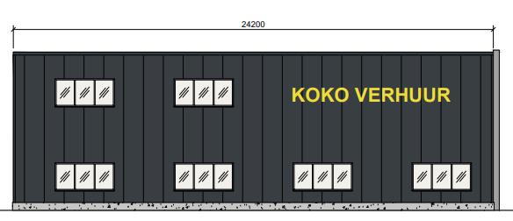
Koko Verhuur

Slide 14
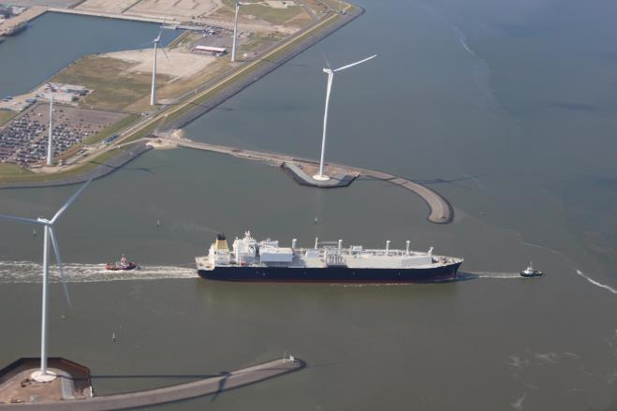
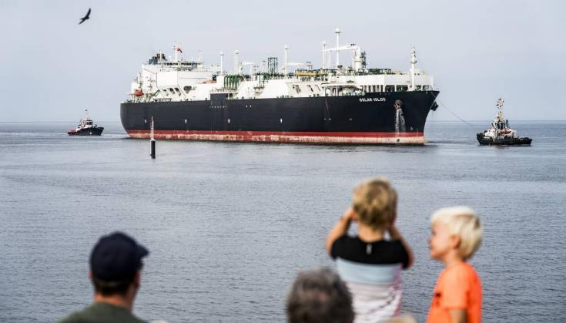
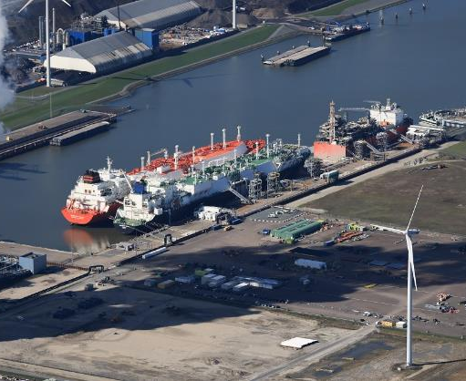
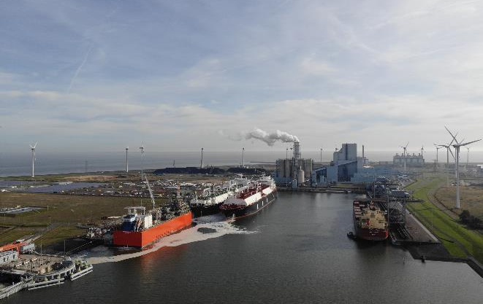
LNG Terminal Eemshaven (mogelijkheid om H2 te importeren)

Slide 15
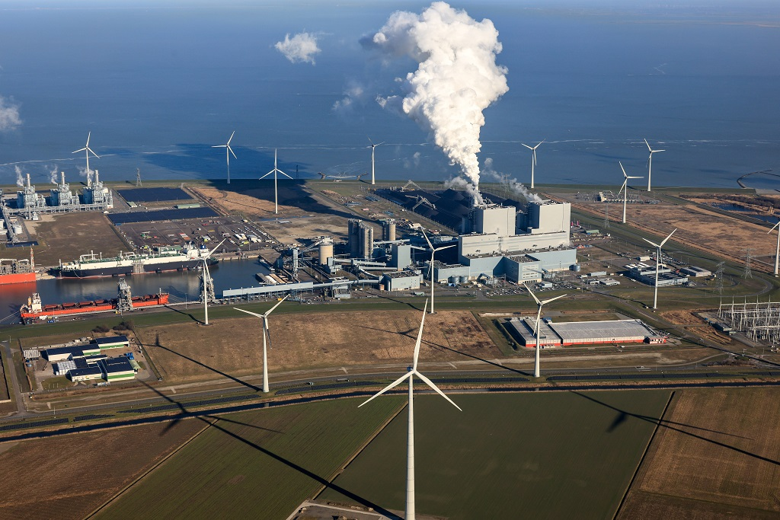
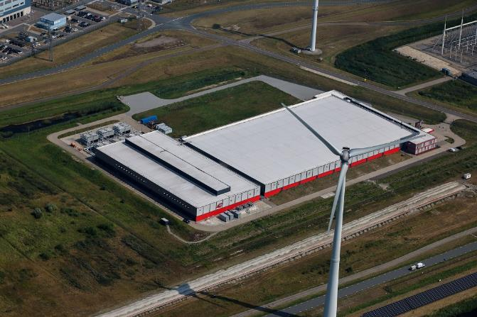
Tweede locatie QTS

Slide 16
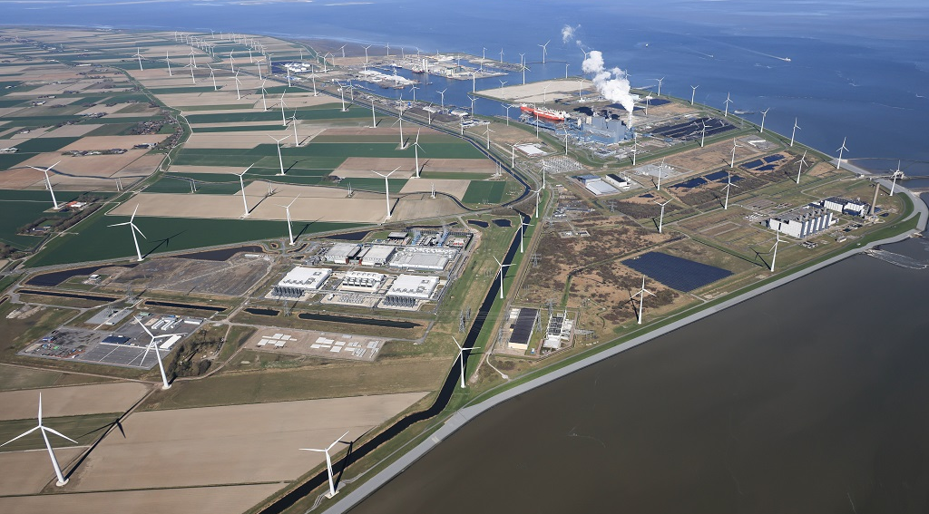
Ontwikkelingen Eemshaven
Nieuwe sleepdienst
Oostpolder
± 600 hectare
Uitbreidingsgebied Eemshaven

Slide 17
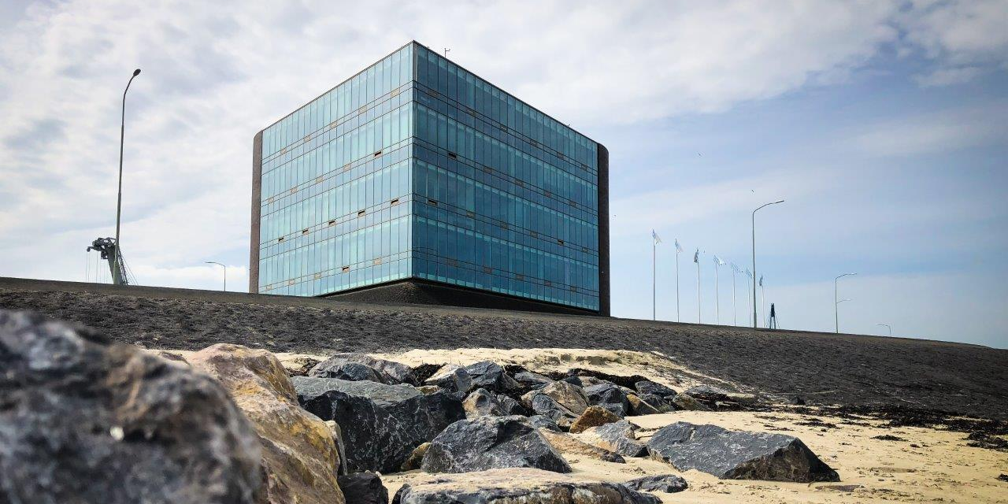
Imago-onderzoek Groningen Seaports
Notes:
Voor realiseren klimaatdoelen absoluut en snel minimaal 6 000 MW wind op zee nodig.
Naast vraag groene energie nu extra opgave groene waterstof.
Boven de wadden
Aanlanding in Eemshaven

Slide 18
Op 7 juni 2023 bestaat de Eemshaven 50 jaar!
Notes:
Voor realiseren klimaatdoelen absoluut en snel minimaal 6 000 MW wind op zee nodig.
Naast vraag groene energie nu extra opgave groene waterstof.
Boven de wadden
Aanlanding in Eemshaven

Slide 19
Notes:
Voor realiseren klimaatdoelen absoluut en snel minimaal 6 000 MW wind op zee nodig.
Naast vraag groene energie nu extra opgave groene waterstof.
Boven de wadden
Aanlanding in Eemshaven

Slide 20
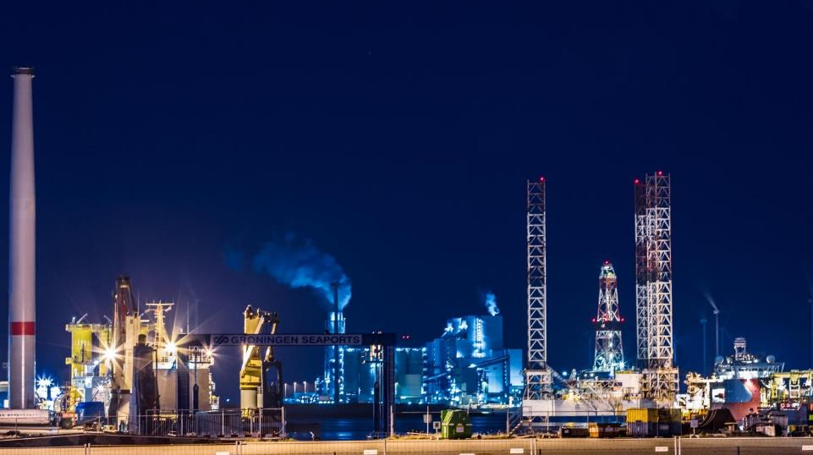
Bedankt voor je aandacht!
WWW.GRONINGEN-SEAPORTS.COM

